Slide 1

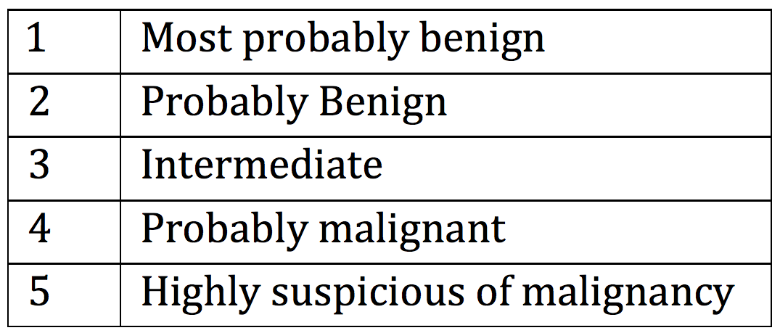
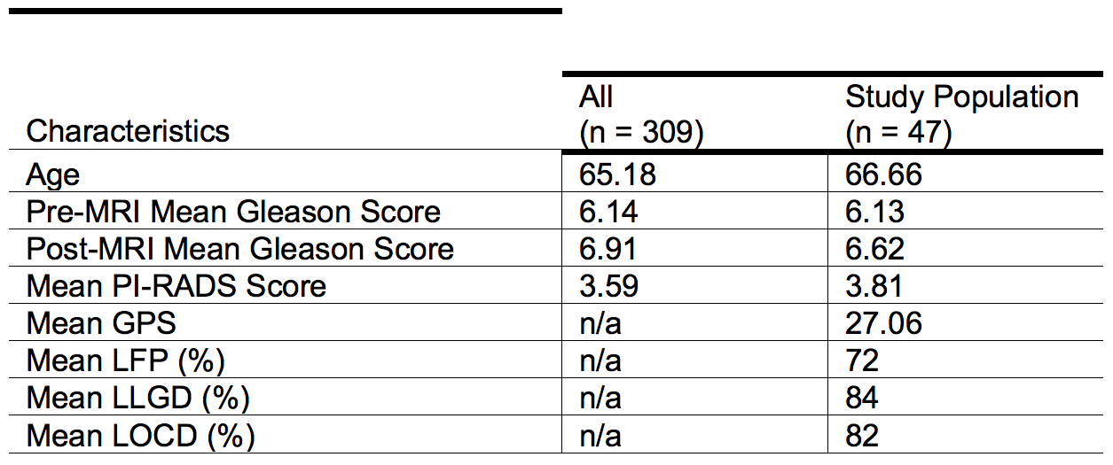
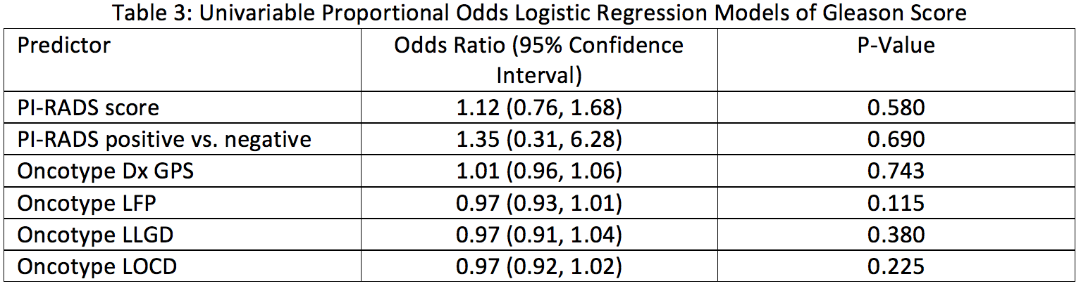
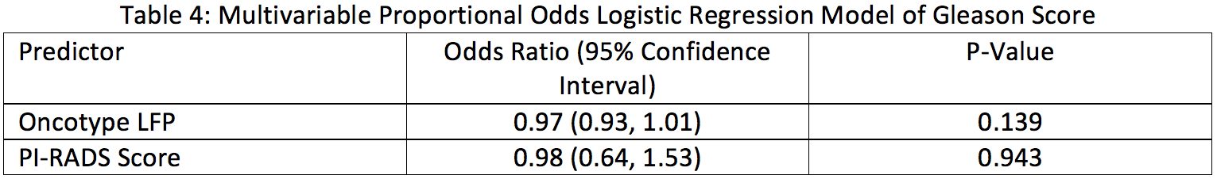
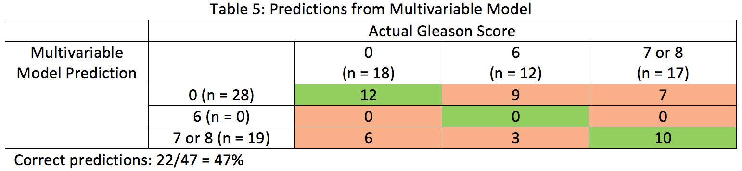
Active Surveillance for Prostate Cancer: A preliminary look at the use of multi-parametric-MRI and cancer genomics for candidate disease monitoring
Rafael Gonzalez, Alex Cantrell, M.D., Marc Dall’Era, M.D., Department of Urology, UC Davis Medical Center
Abstract
Table 1. Prostate Imaging Reporting and Data System (PI-RADS) Scoring Scale
model to predict the likelihood of ‘favorable disease’ defined by Gleason score ≤ 3+4 and stage ≤T2. Likelihood of Favorable Pathology (LFP), Likelihood of Low-Grade Disease (LLGD) and Likelihood of Organ Confined Disease (LOCD) were reported as percentages.
Data was entered into database using Microsoft Excel. Data collected included pre-MRI Gleason score, PI-RADS score, post-MRI Gleason score on repeat biopsy, and Oncotype DX results as GPS, LFP, LLGD and LOCD. POLR was used to model the relationship between PI-RADS or Oncotype scores with Gleason scores (categorized as 0, 6, or 7/8). The parameters obtained from a POLR model were odds ratios, which in this case represented the change in odds of a better vs. worse Gleason outcome for a unit increase in PI-RADS or Oncotype score. Analyses were conducted using the statistical software environment R, version 3.3.2, and POLR estimation was conducted using the R package MASS, version 7.3-45.
Objective: To determine if novel prostate imaging techniques such as multiparametric-MRI (mp-MRI) and genomic assays can be used to tailor surveillance strategies for men on active surveillance (AS) for prostate cancer.
Methods: A retrospective chart review comparing both mp-MRI and genomic assay results with Gleason score on post-MRI prostate biopsy in men with low-intermediate risk for prostate cancer. Proportional odds logistic regression (POLR) was used to model the relationship between Prostate Imaging Reporting and Data System (PI-RADS) or Oncotype scores with Gleason scores.
Results: No predictor (PI-RADS or Oncotype score) is significantly associated with Gleason Score.
Conclusion: In this preliminary study, both PI-RADS and Oncotype scores are not predictors of prostate biopsy. This implies that these two modalities together are not sufficient for predicting Gleason score, however, future research with a larger sample size is required to fully investigate their predictive value.
Table 2. Baseline Cohort Characteristics
Results
Introduction
Baseline Cohort Characteristics (table 2)
309 men were identified to have biopsies and mp-MRI.
47 (n; 15%) men submitted prostate biopsy specimens sufficient for Oncotype DX analysis.
Post-MRI biopsy Gleason Score (figure 1)
  18 (38%) no disease (Gleason 0)
  12 (26%) Gleason 6
  16 (34%) Gleason 7
  1 (2%) Gleason 8
PI-RADS Scores (figure 2)
  5 (11%) no disease (PI-RADS 0)
  0 (0%) PI-RADS 1
  3 (6%) PI-RADS 2
  9 (19%) PI-RADS 3
  23 (49%) PI-RADS 4
  7 (15%) PI-RADS 5
Prostate cancer is the most commonly diagnosed non-skin cancer and the second leading cause of cancer death among men in the United States. It was estimated that in 2016 there were 180,890 new cases and 26,120 deaths as a result of this disease. However, despite its high prevalence, prostate cancer presents in a variety of ways and its natural progression is incredibly heterogeneous. Although 1 in 3 men greater than age 50 will be diagnosed with prostate cancer, approximately 80% of these cancers are of low grade and can be classified as insignificant. As a result, most men with prostate cancer usually die of other causes due to the slow progression of this disease.
The advent of prostate specific antigen (PSA) testing has led to the over diagnosis and overtreatment of prostate cancer. Many of the treatments, which include radical prostatectomy and radiation therapy, are associated with side effects such as sexual and urinary dysfunction, which can be prolonged and profound.
Although active treatment has been the gold standard therapy for newly diagnosed prostate cancer patients, AS has gained widespread acceptance as the initial treatment choice for patients with slow progressing, low- and low-intermediate-risk disease. However, despite variations among established AS guidelines, all protocols require repeat prostate biopsies, some as frequently as annually until the age of 75. Even though biopsies are vital for monitoring any cancer progression, they subject the patients to a very invasive procedure which has been shown to put them at risk for infection and inflammation of the prostate.
Novel, non-invasive modalities for monitoring prostate cancer are constantly being investigated. This includes imaging techniques such as mp-MRI and the PI-RADS scale (table 1), and the Oncotype DX Prostate test, a genomics assay that assesses the aggressiveness and predicts the short- and long-term outcomes of prostate cancer. In our study we investigated PI-RADS and Oncotype DX scores and compare them with post-MRI prostate biopsy results to determine if they are predictive of Gleason score.
Abbreviations: PI-RADS, Prostate Imaging Reporting and Data System; GPS, Genomic Prostate Score; LFP, Likelihood of Favorable Pathology; LLGD, Likelihood of Low-Grade Disease; LOCD, Likelihood of Organ Confined Disease
Table 3 shows the results of univariable (one model per predictor) proportional odds logistic regression model of Gleason score by PI-RADS and Oncotype scores. Table 4 shows multivariable proportional odds logistic regression model of Gleason score by PI-RADS and Oncotype LFP scores. In both univariable and multivariable models, no predictor is significantly associated with post-MRI Gleason score. Table 5 shows predictions of Gleason score from the multivariable model. 22 out of 47 observations (47%) are predicted correctly.
Conclusions
Although MRI and genomics testing can aid in monitoring cancer progression, our results imply that they cannot be used together to predict and replace prostate biopsies. However, it should be noted that our lack of statistical significance could be a result of our small sample size. Additionally, the Oncotype DX genomics assay generally predicts Gleason 4+3=7 or greater. The vast majority of our study population had no disease or Gleason 6 on post-MRI biopsies. The fact that most of our subjects did not have optimal Gleason scores for the Oncotype DX assay could also explain why both PI-RADS scores and Oncotype Dx genomics assays were not predictive of Gleason scores.
Serial prostate biopsies continue to be the gold standard for accurately monitoring a patient’s cancer progression. Additionally, despite their invasiveness some studies show that mortality rates were not found to be higher after prostate biopsy and complications were relatively infrequent. In fact, some studies show repeat biopsies have actually been associated with lower rates of non-infectious complications.
Despite our investigative efforts to make AS less invasive for men with prostate cancer, it currently appears as though prostate biopsies will continue to be the mainstay for monitoring disease progression. However, further research with a larger sample size and with subjects who have Gleason scores optimal for Oncotype DX genomics testing should be investigated.
Methods
Our study was approved by the institutional review board at the University of California, Davis for a retrospective chart review. Data was obtained from medical records from the University of California, Davis Medical Center. The Professional Billing Group (PBG) was queried for a list of patients that have low risk prostate cancer who were undergoing active surveillance and received a prostate biopsy based on CPT codes. Each subject was given a Study ID. A coded identifier list linked the patient study ID number with the identifiers. The designated research personnel also maintained a data collection list containing the study ID number and PHI.
Entry criteria included all men who underwent biopsy of the prostate at UC Davis. Biopsy results included date, Gleason score, number of cores biopsied and number of positive cores. Additional criteria included men who underwent the Oncotype DX Prostate genomic assay and mp-MRI of the prostate. All subjects underwent repeat biopsy only after they were given a diagnosis of low or low-intermediate (Gleason score ≤ 3+4 and stage ≤T2) prostate cancer.
MRI results were analyzed for presence or absence of suspicious lesions defined by PI-RADS score. The Oncotype Dx Prostate test results were reported as an overall expression score (Genomic Prostate Score; GPS) ranging from 0-100 of each biopsy specimen, where higher genomic scores are associated with more aggressive prostate cancer. The score was also incorporated with known clinical features into a multivariate
Abbreviations: PI-RADS, Prostate Imaging Reporting and Data System; GPS, Genomic Prostate Score; LFP, Likelihood of Favorable Pathology; LLGD, Likelihood of Low-Grade Disease; LOCD, Likelihood of Organ Confined Disease
Legend: “Positive”, PI-RADS 3-5; “Negative”, PI-RADS 0-2
Acknowledgements
Nicolai Hübner, M.D. Department of Urology, University of California, Davis, Medical Center
Blythe Durbin-Johnson, Principal Statistician, Department of Public Health Sciences, University of California, Davis
References
Abbreviations: PI-RADS, Prostate Imaging Reporting and Data System; LFP, Likelihood of Favorable Pathology
Dall’Era, Marc A., et al. "Active surveillance for prostate cancer: a systematic review of the literature." European urology 62.6 (2012): 976-983.
Knezevic, Dejan, et al. "Analytical validation of the Oncotype DX prostate cancer assay–a clinical RT-PCR assay optimized for prostate needle biopsies." BMC genomics 14.1 (2013): 690.
Loeb, Stacy, et al. "How active is active surveillance? Intensity of follow up during active surveillance for prostate cancer in the United States." The Journal of urology 196.3 (2016): 721-726.
Pinsky, Paul F., Howard L. Parnes, and Gerald Andriole. "Mortality and complications after prostate biopsy in the Prostate, Lung, Colorectal and Ovarian Cancer Screening (PLCO) trial." BJU international 113.2 (2014): 254-259.
Roethke, Matthias, et al. "PI-RADS classification: structured reporting for MRI of the prostate." Rofo 185.3 (2013): 253-261.
Siegel, Rebecca L., Kimberly D. Miller, and Ahmedin Jemal. "Cancer statistics, 2016." CA: a cancer journal for clinicians 66.1 (2016): 7-30.

